Slide 1
Downtown Toronto vs Manhattan –
The Battle of Neighborhoods [Venues comparison – financial hubs of Canada and New York Boroughs ]

Slide 2
Problem description & API used
Project Description;
Both the boroughs of Toronto and New York, Toronto Downtown and Manhattan respectively are very big financial hubs of their countries and also fascinating to people from different countries outsides. Students, immigrants, Businessmen from different countries have been targeting these regularly.
This case study and Report is to provide the readers required information around the culture and venues which might help them prepare for their decision to pursue career or start of a new life in. Having known to venue and traffic information will help make an informed decision in picking right place to travel, stay and begin a new life.
Foursquare API;
This project will use Four-square API as its prime data gathering source as it is one of the rich collection of location info provide for many fortune 500 companies world wide. it has a database of millions of places, especially their places API which provides the ability to perform location search, location sharing and details about a business.

Slide 3
Workflow & Data wrangling
Work Flows;
API data is used to analyze and cluster the venue info from Downtown Toronto and Manhattan boroughs. Basically, this includes
Data acquisition and cleansing
Data preparation
Feature selection and verification thru visualization
Clustering
Data acquisition and cleansing process;
For Downtown Toronto case, we have extracted table of Toronto’s Borough from Wikipedia page. Then we arrange the data according to our requirements. In the arrangement phase, which applied multiple steps including but not limited to, eliminating “Not assigned” values, combine neighborhoods which have same geographical coordinates at each borough and sorted against the concerned borough. For data verification and further exploration, we use Foursquare API to get the coordinates of Downtown Toronto and explore its neighborhoods. The neighborhoods are further characterized as venues and venue categories.
Sources - https://en.wikipedia.org/wiki/List_of_postal_codes_of_Canada:_M, https://cocl.us/new_york_dataset and Geospatial_Coordinates.csv

Slide 4
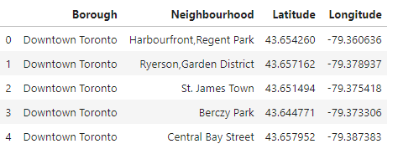
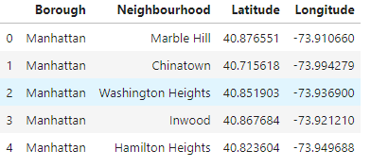
Feature Selection
Feature Selection for analysis – Downtown Toronto and Manhattan
Preparation of "Downtown Toronto" data
Extract data from https://en.wikipedia.org/wiki/List_of_postal_codes_of_Canada:_M Add location data from Geospatial_Coordinates.csv
Eliminate neighborhood column (Nan). Throughout the project, Neighborhood used for clarity
Drop the postal code column Filter for Downtown Toronto borough and set it as index
Extract data from https://cocl.us/new_york_dataset

Slide 5
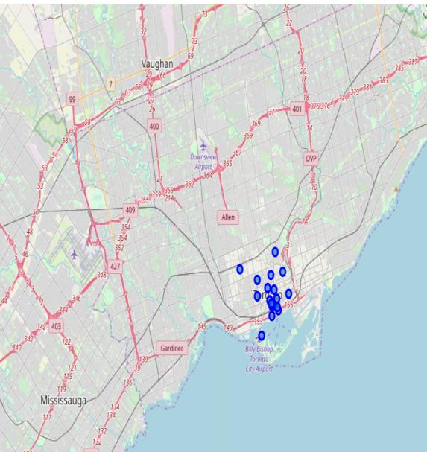
Visualization – Downtown Toronto, On
1 Harbourfront,Regent Park
2 Ryerson,Garden District
3 St. James Town
4 Berczy Park
5 Central Bay Street
6 Christie
7 Adelaide,King,Richmond
8 Harbourfront East,Toronto Islands,Union Station
9 Design Exchange,Toronto Dominion Centre
10 Commerce Court,Victoria Hotel
11 Harbord,University of Toronto 1
12 Chinatown,Grange Park,Kensington Market
13 CN Tower,Bathurst Quay,Island airport,
Harbourfront West,King and Spadina,
Railway Lands,South Niagara
14 Rosedale
15 Stn A PO Boxes 25 The Esplanade
16 Cabbagetown,St. James Town
17 First Canadian Place,Underground city
18 Church and Wellesley

Slide 6
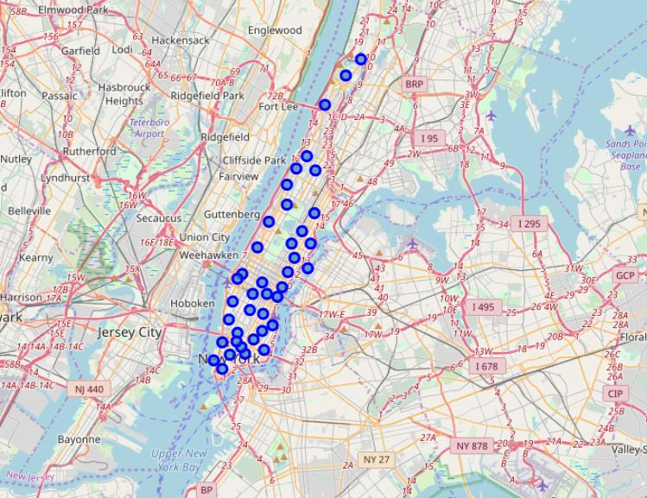
Visualization – Manhattan, NY
1 Marble Hill
2 Chinatown
3 Washington Heights
4 Inwood
5 Hamilton Heights
6 Manhattanville
7 Central Harlem
8 East Harlem
9 Upper East Side
10 Yorkville
11 Lenox Hill
12 Roosevelt Island
13 Upper West Side
14 Lincoln Square
15 Clinton
16 Midtown
17 Murray Hill
18 Chelsea
19 Greenwich Village
20 East Village
21 Lower East Side
22 Tribeca
23 Little Italy
24 Soho
25 West Village
26 Manhattan Valley
27 Morningside Heights
28 Gramercy
29 Battery Park City
30 Financial District
31 Carnegie Hill
32 Noho
33 Civic Center
34 Midtown South
35 Sutton Place
36 Turtle Bay
37 Tudor City
38 Stuyvesant Town
39 Flatiron
40 Hudson Yards

Slide 7
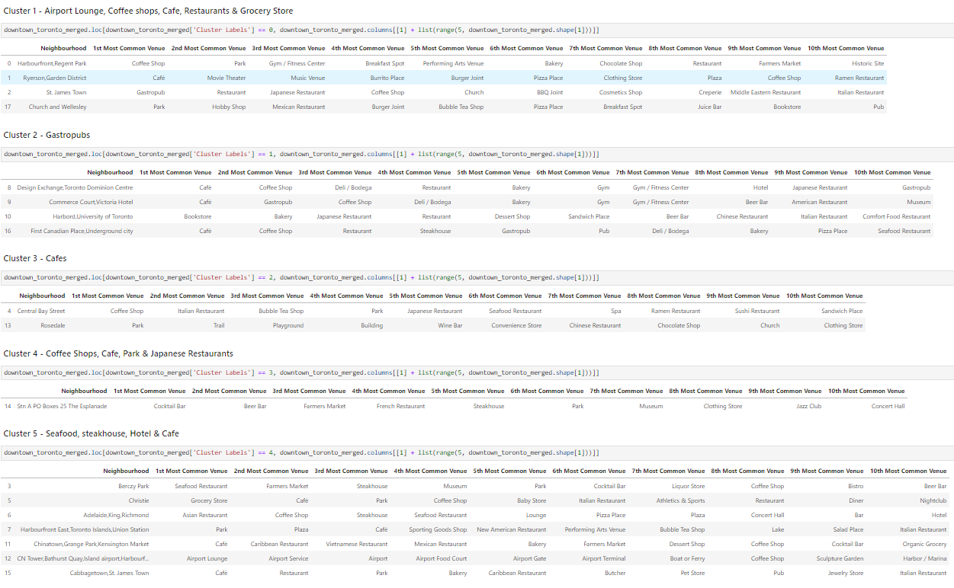
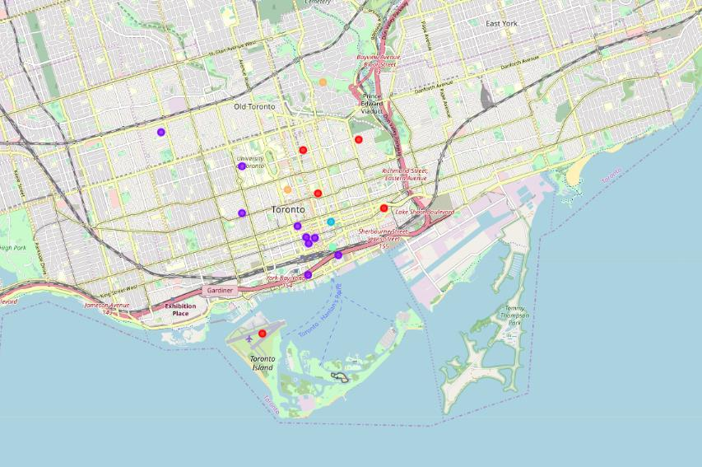
Clustering and segment – Downtown Toronto

Slide 8
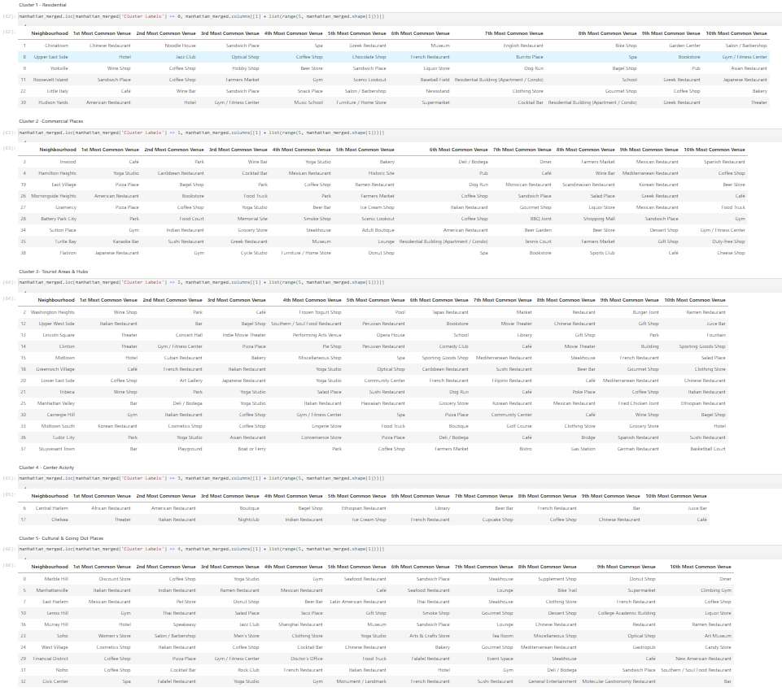
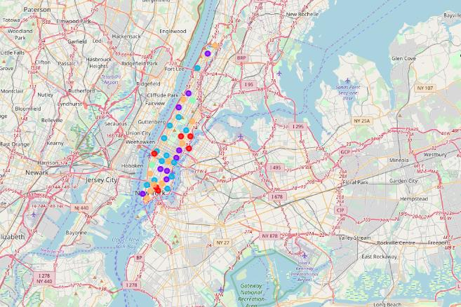
Clustering and segment – Manhattan

Slide 9
Recommendations & Conclusion
Observations & Recommendations
Historical places are situated in Downtown Toronto neighborhoods and monument venues are in Manhattan neighborhoods. Venues like Airport lounges, Harbor, Gym, museums and night clubs are available for tourists in Downtown Toronto. At first sight we can primarily recommend, Downtown Toronto neighborhoods as they have easy access to Airports to save time and save some money. Easy access to traveling always leads to convenience for tourists, students and emigrants.
Conclusion
The downtown Toronto and Manhattan neighborhoods have more like similar venues. Most of the times choices and needs also drive the tourists so Asian might more incline towards the Toronto while European may towards Manhattan due to some cultural background and immigration benefits.

